Slide 1

Time Series - Furniture Sales Forecast
MINI PROJECT

Slide 2
Business Objective
Build a forecast model to predict the furniture , technology, office supplies sales of a certain store

Slide 3
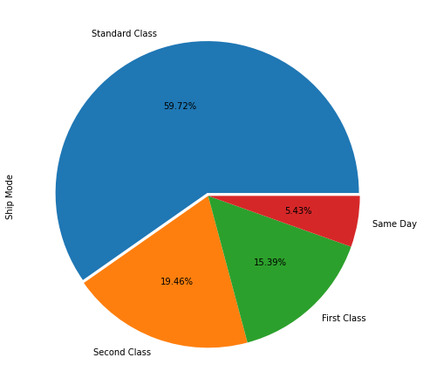
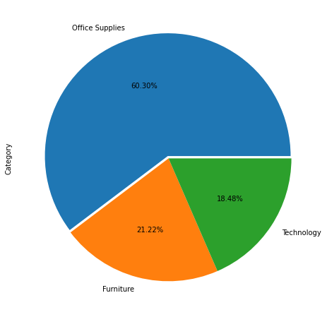
EXPLORATORY DATA ANALYSIS
Shipmode is majorly take place in Standard Class about
59.72%
Maximum order been placed in the category of
Office Supplies

Slide 4
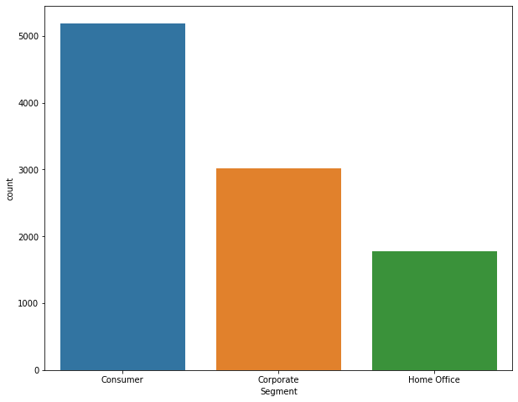
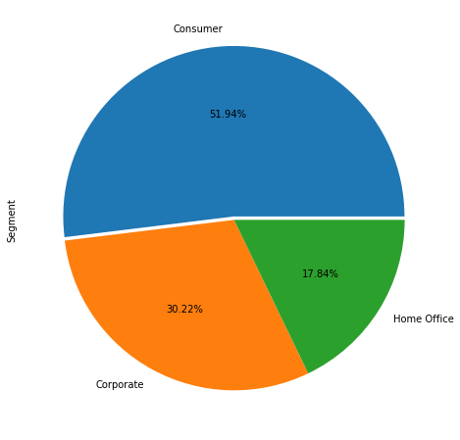
Segment of Consumer the one who are placing most
Number of orders

Slide 5

TECHNICAL SLIDES

Slide 6
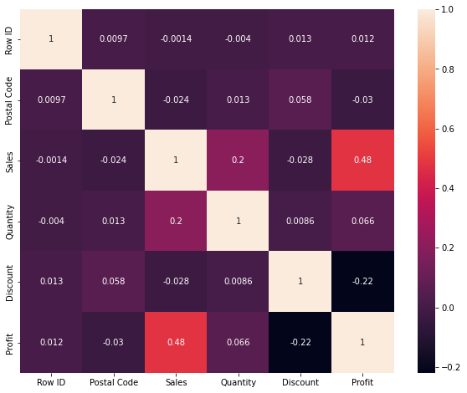
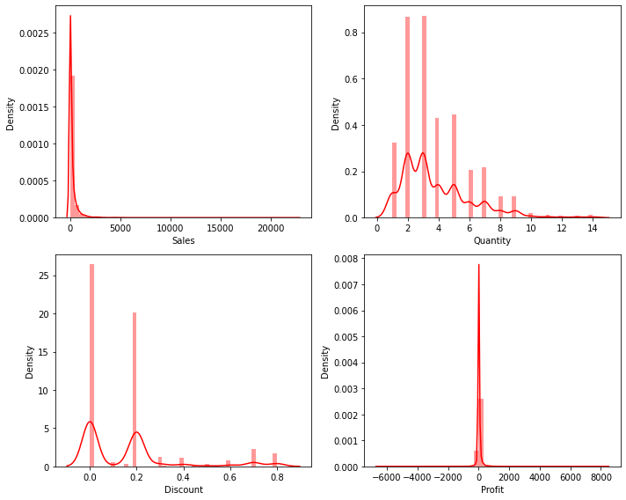
Sales and Profit Show positively correlated about 48%
Some of the data is right skewed

Slide 7
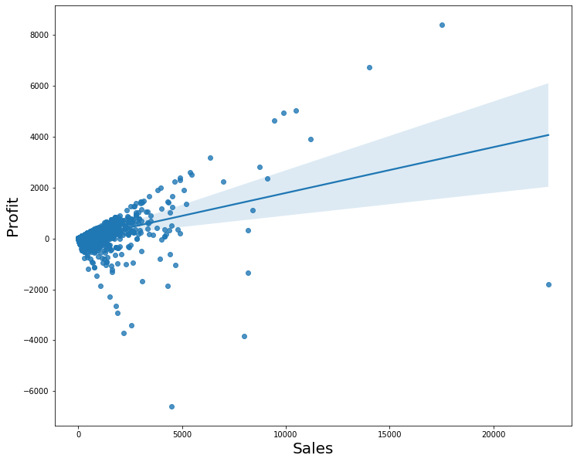
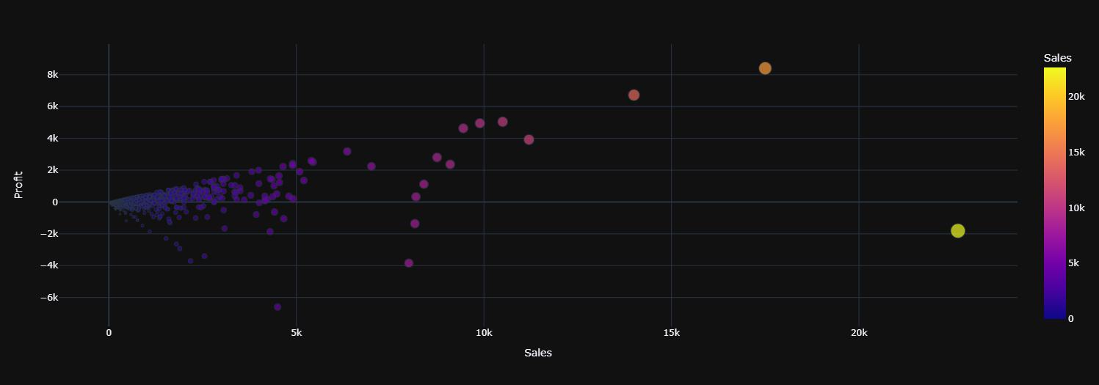
Profit and Sales Showing Strong correlation as our Sales increases Profit also increases

Slide 8
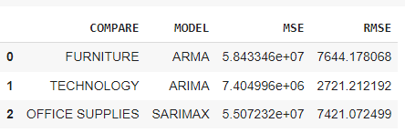
FINDING BEST ALGORITHM
As we can see OFFICE SUPPLIES of SARIMAX model performing better because Error of OFFICE SUPPLIES
Are relatively smaller than other models
SARIMAX is best when data is not Stationary

Slide 9
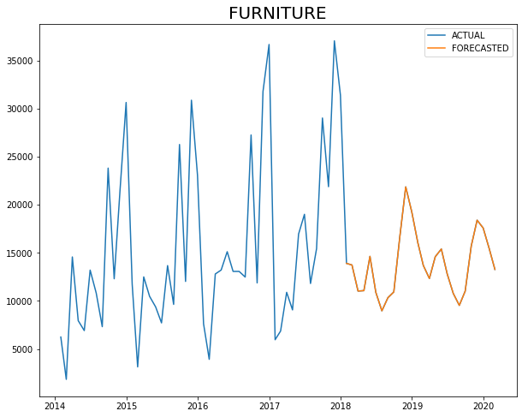
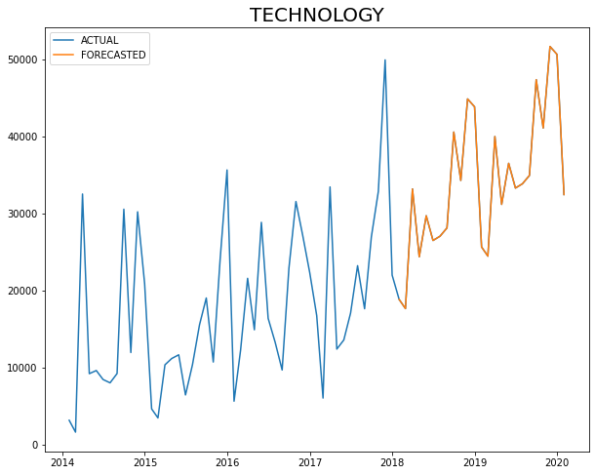
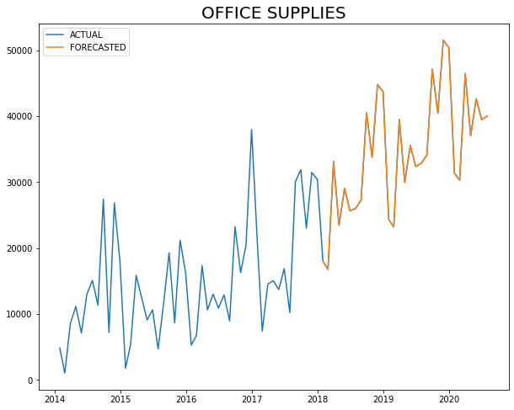
COMPARING
Forecasted sales will be less than the past sales of furniture and will be decreasing over the next couple of years
Forecasted sales will be larger than the past sales of Technology and will be increasing over the next couple of years
Forecasted sales will be larger than the past sales of office supplies and will be increasing over the next couple of years

Slide 10
CONCLUSION
Consumer basically go for Standard class because it is more available option and maybe cheapest or provide free delivery
Sales of furniture will be decrease in near by future because their product quality is not good or they are selling at high priced so they should more focus on their product quality or revise their MRP
Technology and office supplies demand will be increasing in upcoming year so they should also arrange extra storage according to future demand

